Slide 1

Crime prevention
Jan-Niklas Anders
Esat Armagan Kaymaz
Chân Lê
Johanna Regenthal

Slide 2
Agenda
1
Introduction to crime prevention
Case selection
Framework
3
Predictive Policing
PredPol
ShotSpotter
Social media tracking
2
Risk Assessment
COMPAS
4
Discussion & Conclusion
Ethical evaluation
Conclusion
Reflection on group work

Slide 3
Crime Prevention – Suptopics
Crime Prevention
Risk Assessment
Predictive Policing
Notes:
Crime prevention is the attempt to reduce and deter crime and criminals.
Used by criminal justice pratitioners and government
reduce crime,
enforce the law, and
maintain criminal justice.
divided into 2 subtopics
Talk briefly about Case Selection
After general research, -> big names for crime prevention subtopics were found
For smaller cases hard to dig deeper and find not commercialized one‘s or
Which were not based on already found case.

Slide 4










Framework
Goal
Design & Features
Remarks & Evaluation
Business model
Input
Maturity stage
Output & User Interface
Future Outlook
Location of employment
Effectiveness & Efficiency
Business & Industry
Data & Algorithm
Evaluation & Outlook
Notes:
Framework creation
Abductive approach – combination of top-down and bottom-up
IBM as foundation, then mainly bottom-up
Finalized framework consists of 10 criteria – can be seen on slide
For purpose of this presentation, we‘ll not go through each single one for the cases, BUT
Go through clustered approach
1. Business & Industry related criteria
What is the coal and business model?
Is is already implemented, if yes where?
2. Data & Algorighm
What data is used?
How does the user Interface look like?
Lastly 3. Evaluation & Outlook
Self-explanatory
Goal: overall goal – find crimes, evaluate a criminal
Business model – is it governmental, how does the pricing work
Maturity stage – conceptual / experimental / operational / commercialized
Location of employment – Where is it employed? Who uses it
Design & features – what model is used, how does the algorithm work
Input & output – selfexplanatory, incl. User interface, interpretation of output
Effectiveness & Efficiency – how does it perform, results from experiments
Remarks – reflection, drawbacks, criticism, transparency
Future Outlook – possibility of developtent or adoption in other areas

Slide 5



Risk Assessment
„predict whether individual criminals are likely candidates for recidivism“
(Kehl et al., 2017)
Rehabilitation
Sentencing
Pretrial
COMPAS
Correctional Offender Management Profiling for Alternative Sanctions
LSI (LSI-R / LSI-SV)
Level of Service Inventory
PSA
Public Safety Assessment
Notes:
Quote for Risk Assessment, whether a criminal is likely to commit another crime
Usually works like this:
Feed information into the tool
Output a scale, if high someone should not be released
3 main areas
Pretrial (When someone was arrested or waiting for his trial in court - decision if someone should be bailed off)
Sentencing (helping judge in court incarcerated or placed on community supervision)
Rehabilitation (place incarcerated inmates in rehabilitative programs – avoid overcrowded prisons)
3 key players – other are often just adapted versions
COMPAS from Northpoint
LSI – Multi-Health systems
PSA – governmental owned
Players can be assigned to these areas
Always depends on implementation of department

Slide 6
COMPAS – Business & Industry
Decision support for criminal justice practitioners
Different models available
Primary and additional model
Commercially available
Designed for pretrial, sentencing (and rehabilitation)
Implemented in various states in USA
Notes:
Supposed to be a decision support for criminal justice practitioners
Two models of COMPAS available – the primary and additional model
-> Therefore already available on market
As mentioned, they are mainly designed for pretrial and sentencing
Rehabilitation in brackets – depends on implementation of department
State California also uses it as tool to determine rehabilitation program for someone.
It is implemented in various states in the U.S. (e.g. Wisconsin, Florida, California)

Slide 7
COMPAS – Data & Algorithm (1/2)
Combination of static and dynamic (criminogenic) factors
Output different types of risk scales
General recidivism (primary model)
Violent recidivism (primary model)
Pretrial recidivism and release scale (additional model)
Output in bar charts
Claim to improve scales continiously
Notes:
Input are static and dynamic factors (focus on dynamic factors)
Dynamic risk factors are any factors that contribute to recidivism risk that can change over time – also criminogenic factors (employment status, treatment for substance/alcohol abuse)
Static risk factors - not targeted for treatment, as it cannot change (criminal history, age at first arrest, and gender )
They output three different risk scales
General, violent, pretrial recidivism and release scale.
Last one only available in additional model
The user interface shows output in bar charts – which are based on criminogenic factors and criminological theories

Slide 8
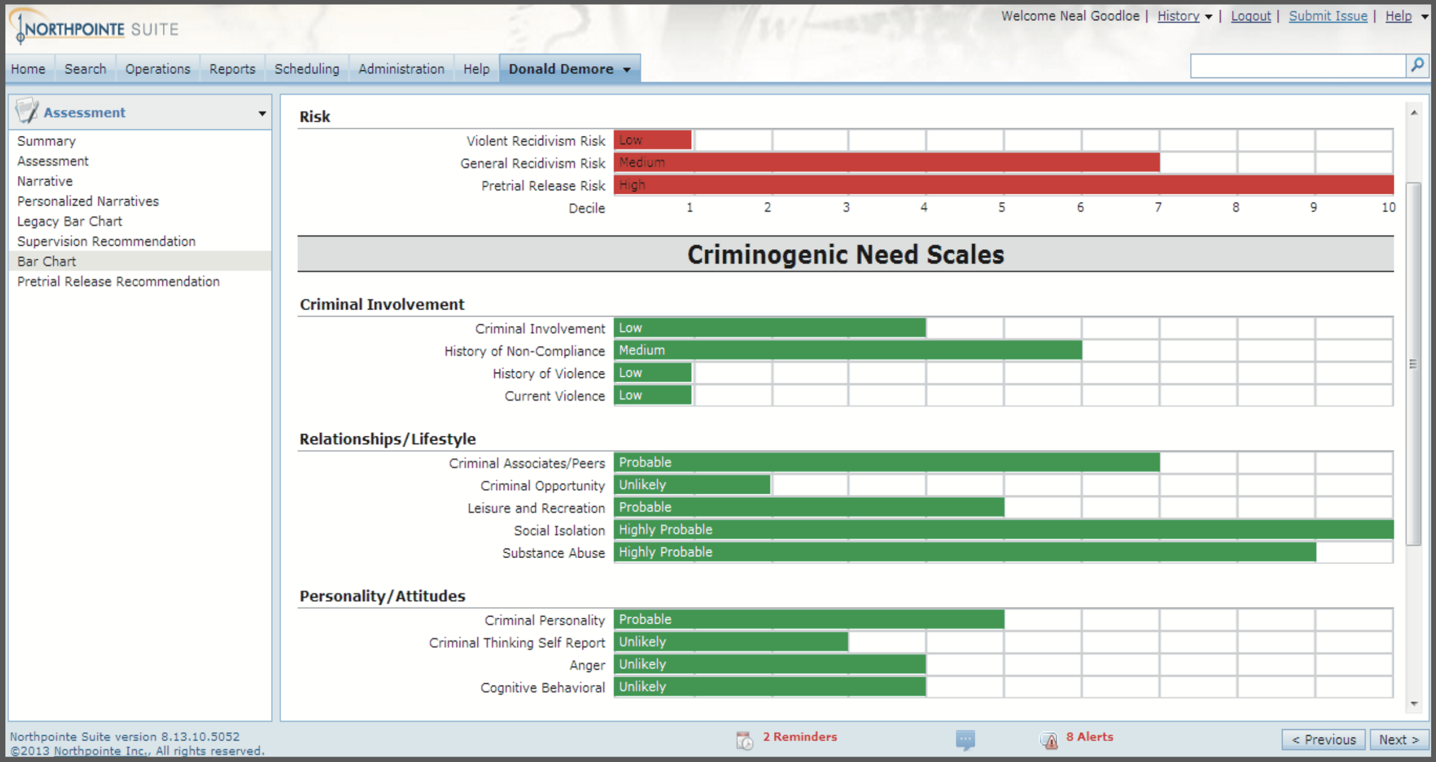
COMPAS – Data & Algorithm (2/2)
Figure 1: User interface of COMPAS (Source: Northpointe, 2019)
Notes:
User interface of COMPAS
On top three risk scales can be seen
Scales of criminogenic need scales

Slide 9
COMPAS – Evaluation & Outlook
Easy to apply
Not in federal oversight
Low transparency
Concerns on validity, accuracy and bias
Accused of high rate of false positives
On trial in summer of 2016
Notes:
Not in federal oversight, but private -> therefore highly intransparent
incorrectly labeled Afro-Americans more likely to high scales than caucasians
While the risk score can help a judge better understand a defendant’s unique situa- tion and relevant factors, the court held that it should not be used to determine the length or severity of the punishment, and certainly should not be counted as an official aggravating or mitigating factor in a sentencing decision.

Slide 10
Predictive Policing – Introduction
The collection and analysis of historical data
for identification and statistical prediction of
individuals or geospatial areas
with an increased probability of criminal activity to
help developing policing intervention and prevention strategies and tactics

Slide 11
Predictive Policing – Categories
Crimes
Place and time with increased risk of time
Offenders
Identify individuals at risk of offending (who is likely to commit crime in the future?)
Perpetrator‘s Identities
Create predictive profiles based on offenders with specific past crimes (which traits/attributes would allow a person to commit a specific crime?)
Victim of crimes
Identify groups/individuals likely to become victims of crimes

Slide 12

PredPol – Business & Industry
Founded in 2012
Originally a research project between the Los Angeles Police Department (LAPD) and the University of California-Los Angeles (UCLA)
One of the market leaders in predictive policing
Notes:
Supposed to be a decision support for criminal justice practitioners
As a business model they offer two models – primary and additional model
Therefore they are already commercialized.
As mentioned, they are mainly designed for pretrial and sentencing. However e.g. the CSRA (California Static Risk Assessment Instrument) also uses it for rehabilitation)
It is implemented in various states in the U.S. (e.g. Wisconsin, Florida, California)

Slide 13
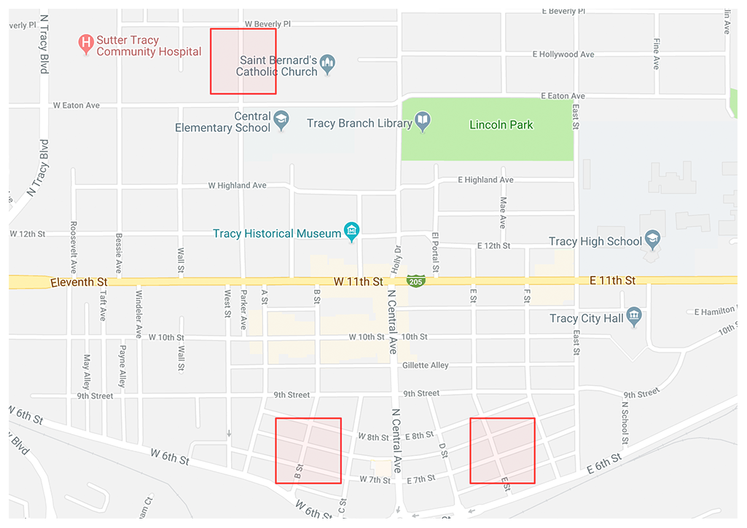
PredPol – Data & Algorithm (1/4)
Predictive Policing: Daily Guidance on Where and When to Patrol
Figure 2: Predictive Policing (Source: PredPol 2020)
Notes:
PredPol can make every dollar spent on patrol in your department more effective. Proactively patrolling areas where crimes are most likely to occur has been proven to reduce the incidence of those crimes. Reducing even one instance of one of type of crime can free up two or more hours of an officer’s patrol time. In other words, reducing just one crime per shift can add another 2 hours of effective patrol time. That’s like getting a 20% increase in your patrol staff for a fraction of the cost!
Predictive Policing: Daily Guidance on Where and When to Patrol
PredPol uses a data-driven approach to direct patrol operations. Historical event datasets are used to train the algorithm for each new city (ideally 2 to 5 years of data). PredPol then updates the algorithm each day with new events as they are received from the department. This information comes from the agency’s records management system (RMS).
PredPol uses ONLY 3 data points – crime type, crime location, and crime date/time – to create its predictions. No personally identifiable information is ever used. No demographic, ethnic or socio-economic information is ever used. This eliminates the possibility for privacy or civil rights violations seen with other intelligence-led or predictive policing models.
Predictions are displayed as red boxes on a web interface via Google Maps. Each box is a 500 x 500 foot square. The boxes represent the highest-risk areas for each day and for the corresponding shift: day, swing or night shift. Officers are instructed to spend roughly 10% their shift time patrolling PredPol boxes (about 6 minutes per hour).
You can supplement the PredPol patrol guidance by leveraging your own analytics to create custom patrol boxes. These can be based on specific intelligence, known upcoming events, risk terrain modeling or other predictors of hotspot activity.

Slide 14
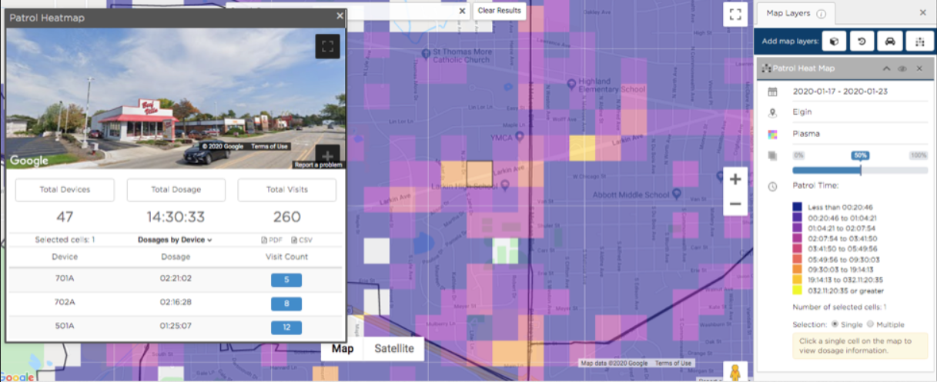
PredPol – Data & Algorithm (2/4)
Patrol Operations: Mission Planning and Patrol Resource Management
Figure 3: Patrol Operations (Source: PredPol 2020)
Notes:
Patrol Operations: Mission Planning and Patrol Resource Management
Drive culture change within your department. Go from reactive to preventative. Have your officers focus on crime hot spots instead of chasing calls for service.
PredPol lets you set specific missions for each shift, beat and day of the week. Missions are collections of selected crimes or events. PredPol displays the highest-probability locations for the events associated with each mission.
If your agency has GPS or AVL, PredPol can also track “dosage” of PredPol boxes. Dosage refers to the amount of time officers spend in PredPol boxes. This allows command staff to ensure that recommended areas are being patrolled.
PredPol also creates patrol heat maps that allow command staff to see if any areas of their jurisdiction are being over-patrolled or under-patrolled. Use the patrol heat map to track officer location information across your entire jurisdiction. PredPol logs every visit by time, duration and vehicle ID.
PredPol is an important element of your Real-Time Crime Center (RTCC). You can display and oversee active missions, current officer locations, targeted patrol areas, and patrol status at the beat and departmental levels.
https://cdn2.hubspot.net/hubfs/3362003/Patrol%20Checklist%20FINAL.pdf?__hssc=103758111.1.1582212758060&__hstc=103758111.873dc0bbe07031eeab166b7eae48fa52.1582212758060.1582212758060.1582212758060.1&__hsfp=1227424015&hsCtaTracking=bd252c2a-a80d-426f-8924-59effb7776f8%7C5f077b4f-e56d-4e08-a8d4-b6124dac871e
Set specific mission, which (related) crime types to target in shifts & beats

Slide 15
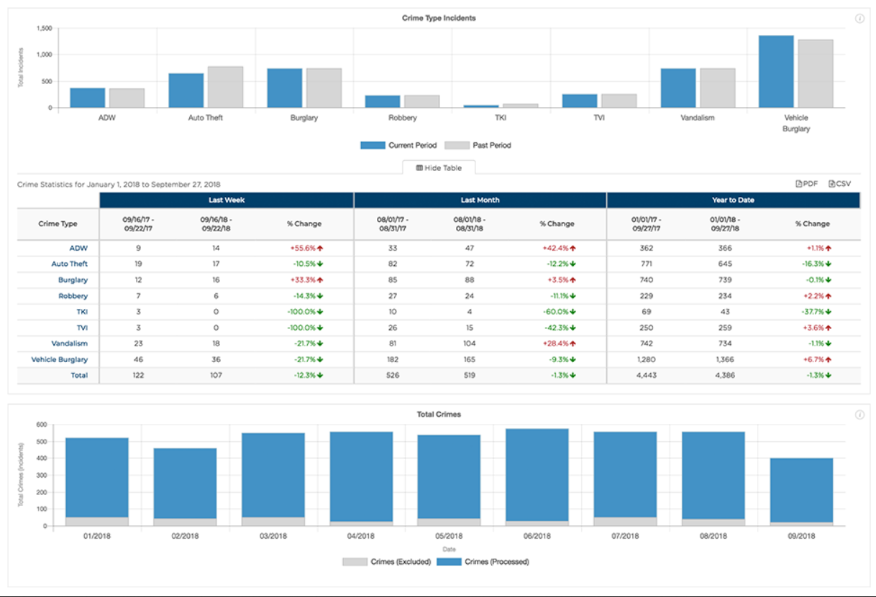
PredPol – Data & Algorithm (3/4)
Analytics: Closing the Loop with Data and Reporting
Figure 4: Analytics (Source: PredPol 2020)
Notes:
Analytics: Closing the Loop with Data and Reporting
We believe that your data belongs to you and you should be able to access it quickly and painlessly. PredPol allows you to see your crime and operations data graphically as well as download it in CSV or PDF format.
PredPol’s COMPSTAT-like analytics and reporting module provides a quick summary of a rich and complex dataset. Our point-and-click interface lets you create custom reports instantly – by any combination of crime types, missions, districts and shifts over any date range. The goal is to simplify the underlying data and present it in an actionable format. It is used for activities such as mission planning and setting resource levels. This follows the philosophy “you can’t manage what you don’t measure.”
This information can also be shared with local government or the community to see the relative patrol coverage across the city. It is a key element of the transparency that PredPol is trying to bring to police departments and the communities they serve.

Slide 16
PredPol – Data & Algorithm (4/4)
Predictions based only on victimization information, i.e. crimes that have been reported to police:
Crime type
Crime location
Crime date and time
Predicts where and when a crime is most likely to occur, not who is likely to commit a crime.
No personal data, information about individuals or demographics are utilized

Slide 17
PredPol – Evaluation & Outlook
The Los Angeles Police Department’s Foothill Division saw a 20% drop in predicted crimes year over year from January 2013 to January 2014 and experienced a day without crime on February 13, 2014.
The Atlanta, GA Police Department saw aggregate crime drop 19% and attribute much of the sustained reduction to PredPol's deployment.
The Alhambra, CA Police Department reported a 32% drop in burglaries and a 20% drop in vehicle theft since deploying in January 2013. The city reported its lowest month of crime in history in May 2014.
The Norcross, GA Police Department has had a 15-30% reduction in burglaries and robberies just four months after deploying in August 2013.
The Modesto, CA Police Department just reported the lowest crime rates in 3 years since deployment in January 2014, including an 18% reduction in residential burglary and a 13% reduction in commercial burglary.

Slide 18


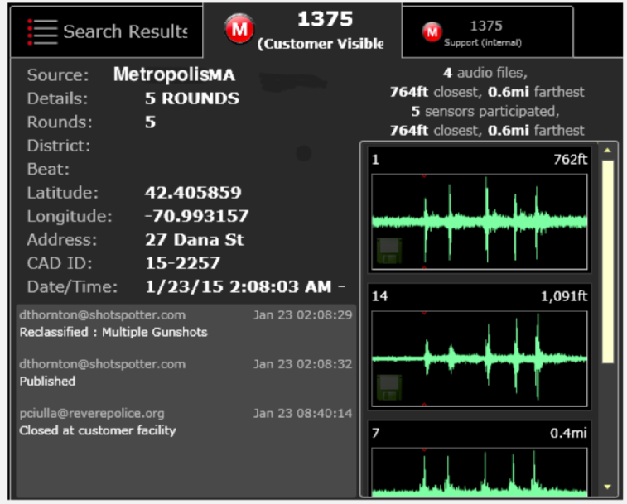
ShotSpotter – Business & Industry
California-based company in business for 24 years
Originally focus on “Flex“ - gunshot detection
“Missions“ software: enables the design of police work based on prediction
Creation of forensic reports on the offences
→ Reports: prove in court when and where the crime took place (audio file,
analysis)
Figure 5: ShotSpotter technology on lamppost (Source: East Bay Express, 2014)
Figure 6: Incident review (Source: ShotSpotter, 2015)
Notes:
Supposed to be a decision support for criminal justice practitioners
As a business model they offer two models – primary and additional model
Therefore they are already commercialized.
As mentioned, they are mainly designed for pretrial and sentencing. However e.g. the CSRA (California Static Risk Assessment Instrument) also uses it for rehabilitation)
It is implemented in various states in the U.S. (e.g. Wisconsin, Florida, California)

Slide 19
ShotSpotter – Data & Algorithm (1/2)
Less than 20% of illegally fired shots are reported to law enforcement
→ help law enforcement in the area of gun violence to make cities safe
Sensors that record acoustic signals will be strategically positioned
Processing of sounds in the area:
Determine the exact position of the crime scene
Analysis whether the sounds are gunshots
Incident Review Center: Evaluation of recordings and provision of additional assessments
Notifications: Operations Center, patrol cars, smartphones of the police officers in less than 60s

Slide 20
ShotSpotter – Data & Algorithm (2/2)
Provision of data for other processing via API:
→ Real-time map, where the incident is located
→ Nearby cameras
→ License Plate Readers
→ Drones
→ Prediction models for police operations
Costs: $65,000 to $95,000 per square mile per year (minimum size: 3 square miles)
Used in 100 cities in an area of 700 square miles

Slide 21
ShotSpotter – Evaluation & Outlook
National Gunfire Index of 2017: use of firearms with 86,665 cases in 87 cities in the USA
→ 237 cases per day, average of 3.7 shots per offence
Shottspotter statistics:
→ 2014 vs. 2013: Number of shots fired in the 28 participating cities reduced by 28.8%
on average
→ Oakland (CA): 66% reduction in shootings per square mile
→ Cincinnati (OH): 48% reduction in Avondale shooting victims
→ Chicago (IL): 40% reduction in Englewood shootings
Criticism:
→ Too costly?
→ Effectiveness?
→ Privacy concerns

Slide 22

Predictive Policing – Social Media Tracking (1/3)

Slide 23
Predictive Policing – Social Media Tracking (2/3)
Crime event prediction with dynamic features (Rumi et al., 2018)
Research paper: improvement of crime prediction quality by incorporating dynamic data?
Data basis: Static data (historical, demographic, geographic) + dynamic (Foursquare user behavior)
Offences distinguished:
Theft, Unlawful Entry, Drug Offence, Traffic Related Offence, Fraud and Assault
Dynamic data used to calculate new features:
Visitor Ratio, Region Popularity, Observation Frequency, Visitor Entropy, Visitor Homogeneity

Slide 24
Predictive Policing – Social Media Tracking (3/3)
Crime event prediction with dynamic features (Rumi et al., 2018)
Evaluation on NYC data: from 03/2012 to 02/2013 with offences and their location and time
Foursquare data: 43,964 venues with 227,428 check-ins from 1,083 users
Dynamic features as new indicator
Evaluation on Brisbane dataset: dynamic features had different significance
Inclusion of dynamic features: has proven to be positive for Brisbane and New York

Slide 25
Ethical Evaluation and Considerations (1/3)
1. The dataset is incomplete
Limited datasets for non-property crimes
“In short, the numbers are greatly influenced by what crimes citizens choose to report, the places police are sent on patrol, and how police decide to respond to the situations they encounter.”
Notes:
different applications of predictive policing however consider ethical aspects and drawbacks
3 major disadvantages of using predictive policing during the law enforcement progress
Firstly, incomplete dataset
not able to know every committed crime, we have some limitations
property crimes have high report ratio
Because of limited datasets for non-property crime, vulnerabilities of bad data and missing value grow

Slide 26
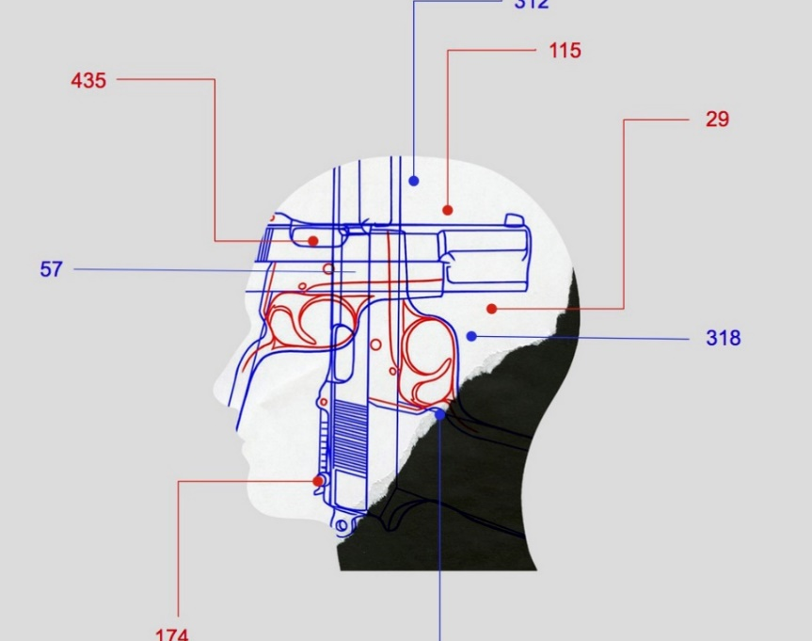
Ethical Evaluation and Considerations (2/3)
2. The system is not transparent
Software may be subject to commercial-in-confidence provisions in contracts
Even it is available, algorithms cannot be fully comprehended
Privacy concerns while collecting large amounts of personal data
Notes:
Transparency availability to other actors to monitor the workings and performance of this actor.
So that is closely related to accountability
full transparency and comprehensibility is rarely possible in predictive policing
Firstly, software may be subject of private property of provider company. The rights might be protected under the agreed contract
Secondly, most of the predictive models are mainly data driven instead of theory driven. Too much emphasis on correlations, instead of causality
where a senior police officer is asked to account for deployment decisions made -> temptation to outsource aspects of the
decision-making process to technological tools If the tool is relevantly neutral, such as word-processing software used to record a
human decision, this will rarely be a problem. However predictive policing tools depend on multiple assumptions about which decision-makers themselves may be unaware
As a nature of algorithms except perhaps to technical experts.
collection of large amounts of data (big data) by the government, but also commercial companies, raises privacy concerns as there is often not enough transparency about what and how much data are collected. limit?

Slide 27
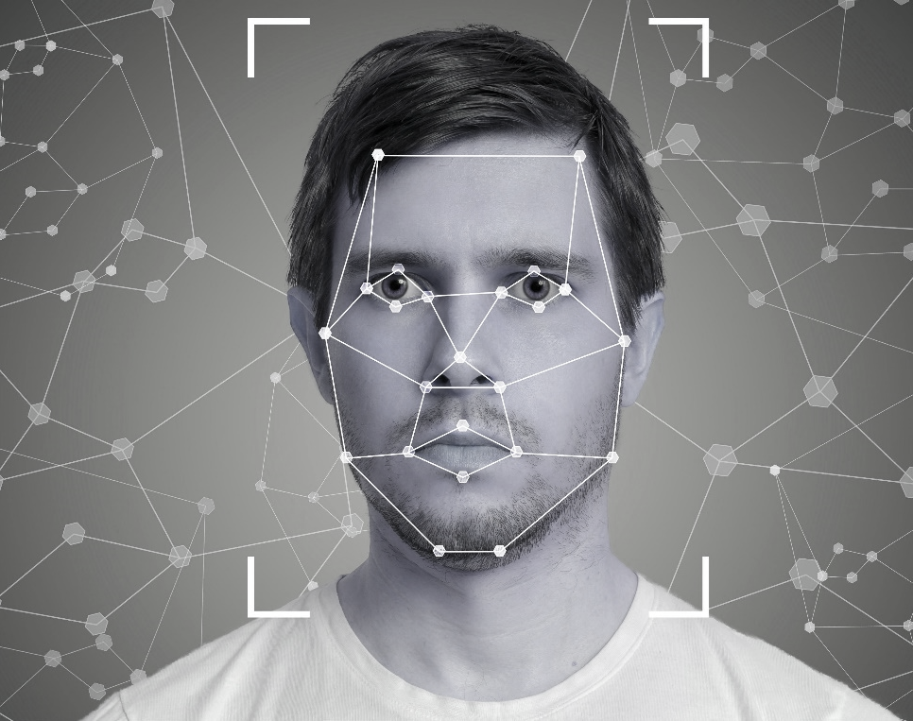
Ethical Evaluation and Considerations (3/3)
3. The judgements tend to stay racially biased
Flagging certain areas as hot spots
Changes of law enforcement officers’ orientation toward people living there
Notes:
Because race is closely correlated in the United States with geographical location and socio-economic status, it is impossible to fully control for proxy effects in the data.
vicious cycle, dedicates more of its resources to patrolling and investigating blacks in urban areas. , the resulting arrest population is not a proportional representation of all offenders, but rather disproportionately represents black citizens
these predictions are seen to have the capacity to change not only how we understand certain locations as high-crime areas, but the flagging of particular areas as hot spots also changes our orientation
law enforcement officers’ orientation toward those areas and people living there
Even when we are simply “counting” things in the world, we are also engaged in processes of classification and categorization
predictive policing cannot create magic for the representation of world
. “The process shouldn’t change the way policing is done, it should make it more efficient,” he says. “The real world is messy and fuzzy
overreliance of predictive policing technologies and addressed that there is always a need for human analysis

Slide 28

Conclusion
Field is still in development
Market is unsaturated
Machine Learning techniques are widely applied
BUT
Results have to be scientifically proven
Transparency issues

Slide 29

Reflection on group work

Slide 30
References (1/2)
Carroll, J. (2019). Pros And Cons Of San Diego's Gunshot Detection System. [online] KPBS Public Media. Available at: https://www.kpbs.org/news/2019/jun/19/pros-and-cons-gunshot-detection-system/ [Accessed 24 Feb. 2020].
Charlotte Observer. (2020). ShotSpotter boss defends system. [online] Available at: https://www.charlotteobserver.com/news/local/crime/public-safety-blog/article60938427.html#storylink=cpy [Accessed 24 Feb. 2020].
Cohen, I.G. and Graver, H.S. (2017). Cops, docs, and code: a dialogue between big data in health care and predictive policing. UCDL Rev., 51, p.437.
Craig, G. (2019). Rochester crime: Evidence collecting tool called into question. [online] Democrat and Chronicle. Available at: https://eu.democratandchronicle.com/story/news/2017/11/17/shot-spotter-technology-relshot-spotter-technology-coming-under-increased-scrutiny-judicial-communit/844335001/ [Accessed 24 Feb. 2020].
Ferguson, A.G. (2016). Policing predictive policing. Wash. UL Rev., 94, p.1109.
Fraga, B. (2018). After Too Many Shots Missed, Fall River, Mass., Ends Deal with ShotSpotter. [online] Govtech.com. Available at: https://www.govtech.com/public-safety/After-Too-Many-Shots-Missed-Fall-River-Mass-Ends-Deal-with-ShotSpotter.html [Accessed 24 Feb. 2020].
Greengard, S. (2012). Policing the future. Communications of the ACM, 55(3), pp.19-21.
Hardyns, W. and Rummens, A. (2018). Predictive policing as a new tool for law enforcement? Recent developments and challenges. European journal on criminal policy and research, 24(3), pp.201-218.
James, N. (2015). Risk and Needs Assessment in the Criminal Justice System. [online] Available at: https://www.everycrsreport.com/files/20150724_R44087_0c47cc191ecc982888fa182c82ef0099a86eca8d.pdf [Accessed 23 Feb. 2020].
Karppi, T. (2018). “The Computer Said So”: On the Ethics, Effectiveness, and Cultural Techniques of Predictive Policing. Social Media+ Society, 4(2), p.2056305118768296
Kehl, D., Guo, P. and Kessler, S. (2017). Algorithms in the Criminal Justice System: Assessing the Use of Risk Assessments in Sentencing. [online] Available at: https://dash.harvard.edu/bitstream/handle/1/33746041/2017-07_responsivecommunities_2.pdf [Accessed 23 Feb. 2020].

Slide 31
References (2/2)
Meijer, A. and Wessels, M. (2019). Predictive Policing: Review of Benefits and Drawbacks. International Journal of Public Administration, vol 42, no. 12, pp 1031-9. [online] Available at: https://www.tandfonline.com/doi/full/10.1080/01900692.2019.1575664 Accessed 24 Feb. 2020].
Northpointe (2015). Practitioner’s Guide to COMPAS Core. [online] Available at: https://assets.documentcloud.org/documents/2840784/Practitioner-s-Guide-to-COMPAS-Core.pdf [Accessed 23 Feb. 2020].
Perry, W.L., Perry, W.L., McInnis, B., McInnis, B., Price, C.C., Price, C.C., Smith, S., Smith, S., Hollywood, J.S. and Hollywood, J.S. (2013). Predictive Policing: The Role of Crime Forecasting in Law Enforcement Operations. [online] Rand.org. Available at: https://www.rand.org/pubs/research_reports/RR233.html [Accessed 24 Feb. 2020].
PredPol (n.d.). NEW Feature Spotlight: Dosage Flags. [online] blog.predpol.com. Available at: http://blog.predpol.com/new-feature-spotlight-dosage-flags [Accessed 24 Feb. 2020].
PredPol. (n.d.). Law Enforcement | PredPol Law Enforcement Intelligence Led Policing Software | PredPol Law Enforcement Intelligence Led Policing Software. [online] Available at: https://www.predpol.com/law-enforcement/ [Accessed 24 Feb. 2020].
Robinson, D. and Koepke, L. (2016). Stuck in a Pattern. Early evidence on" predictive policing.
Rumi, S., Deng, K. and Salim, F. (2018). Crime event prediction with dynamic features. EPJ Data Science, 7(1).
Samuels, A. (n.d.). Predictive Policing Technology Dramatically Reducing Crime in Large & Small Communities Across U.S. & Overseas. [online] blog.predpol.com. Available at: http://blog.predpol.com/reductions-in-crime [Accessed 24 Feb. 2020].
Shapiro, A. (2017). Reform predictive policing. Nature News, 541(7638), p.458.
ShotSpotter. (2017). 2017NGI - ShotSpotter. [online] Available at: https://www.shotspotter.com/2017ngi/ [Accessed 24 Feb. 2020].
ShotSpotter. (2020). Home - ShotSpotter. [online] Available at: https://www.shotspotter.com [Accessed 24 Feb. 2020].
Turner, S., Hess, J., Bradstreet, C., Chapman, S. and Murphy, A. (2013). Development of the California Static Risk Assessment (CSRA): Recidivism Risk Prediction in the California Department of Corrections and Rehabilitation. [online] Available at: http://ucicorrections.seweb.uci.edu/files/2013/12/Development-of-the-CSRA-Recidivism-Risk-Prediction-in-the-CDCR.pdf [Accessed 23 Feb. 2020].

Slide 32
Sources – Icons and Figures
Figure 1: http://www.northpointeinc.com/files/downloads/Northpointe_Suite.pdf
Figure 2: https://www.predpol.com/wp-content/uploads/2018/09/le-predictions-1.png
Figure 3: https://blog.predpol.com/hs-fs/hubfs/NEW%20Patrol%20Heat%20Map5.png?width=1564&name=NEW%20Patrol%20Heat%20Map5.png
Figure 4: https://www.predpol.com/wp-content/uploads/2018/09/le-analytics_02.png
Figure 5: https://www.eastbayexpress.com/oakland/shotspotter-lobbied-oakland-officials-in-apparent-violation-of-law/Content?oid=3907581
Figure 6: https://www.shotspotter.com/wp-content/uploads/2019/05/DFR-Example-.pdf
Icons: https://icons8.de
Further images: pixabay.com, pexels.com

Slide 33

Thank you for your attention! Any Questions?

